Slide 1





Attendance survey:
https://forms.gle/qQ8TrExBUsyxtxH88
Optimization with /
15.003 Analytics Tools
Sean Lo (seanlo@mit.edu) Yu Ma (midsumer@mit.edu)

Slide 2



Introduction: What is Julia?
Ease of coding
A fast and easy-to-use programming language, tailored for scientific computing:
Developed in MIT in 2012
“Python-like” syntax and “C-like” speed
(my biased opinion)
Speed

Slide 3
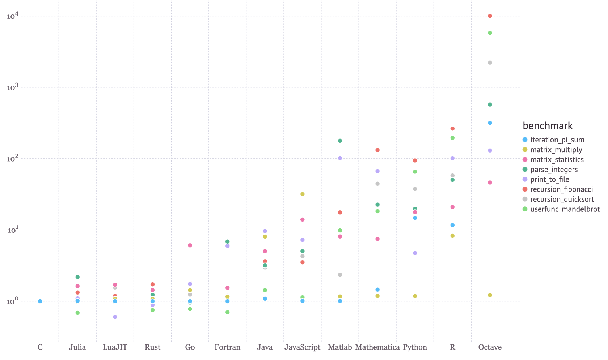
Julia is fast
Julia is nearly as fast as C, while maintaining the flexibility of a high-level language!

Slide 4
What makes Julia special?
High-level language: abstracts away e.g. memory usage
Dynamic language: “reads like English”, can be used interactively, good for prototyping
High-performance: vanilla Julia can be very fast (unlike Python)
Multiple dispatch: “defines function behavior across combinations of argument types”
Growing package ecosystem:
Statistics: StatsBase.jl and Statistics.jl
Machine learning: MLJ.jl, and Flux.jl for deep learning
Data tools: DataFrames.jl, CSV.jl, Arrow.jl and Spark.jl for big data
Data visualization: Plots.jl, Makie.jl
Optimization: JuMP.jl
Differential equations: DifferentialEquations.jl
Notes:
https://jump.dev/JuMP.jl/stable/installation/#Supported-solvers

Slide 5




Introduction: What is JuMP?
Programming language:
A modelling language built on Julia, “supporting packages for mathematical optimization”
Unified interface for different solvers
Modelling language:
Optimization solvers:

Slide 6
Agenda
Part 1: 9:00am – 10:20am: Introduction to Julia (80 mins)
Break: 10:20am – 10:40am
Part 2: 10:40am – 12:00pm: Introduction to Optimization (80 mins)

Slide 7
Part 1: Introduction to Julia

Slide 8
Break
Resume at 10:40
Attendance survey:
https://forms.gle/qQ8TrExBUsyxtxH88

Slide 9
Part 2: Introduction to JuMP

Slide 10
Introduction
Overview of optimization
How to formulate optimization problems
Model implementation in Julia/JuMP
Detour: introduction to Julia
Model interpretation and takeaways
Notes:
https://jump.dev/JuMP.jl/stable/installation/#Supported-solvers

Slide 11
What is Optimization?
Optimization is a field of mathematics that involves finding the minimum or the maximum of a function under constraints.
Most problems in real life where there is uncertainty can be modeled under an optimization framework.
Why? When making decisions, we aim to achieve certain objectives while following some requirements.
Optimization allows us to formulate these problems mathematically and take a data-driven approach to decision-making.
Notes:
https://jump.dev/JuMP.jl/stable/installation/#Supported-solvers

Slide 12
What is Optimization?
Optimization is a field of mathematics that involves finding the minimum or the maximum of a function under constraints.
Most problems in real life where there is uncertainty can be modeled under an optimization framework.
Why? When making decisions, we aim to achieve certain objectives while following some requirements.
Optimization allows us to formulate these problems mathematically and take a data-driven approach to decision-making.
Examples:
“How should we schedule games to:
… maximize primetime viewership?
… minimize team travel distances?
… maximize rivalries at end of season?”
“Who should I include on my team roster to maximize team performance?”
Notes:
https://jump.dev/JuMP.jl/stable/installation/#Supported-solvers

Slide 13
Objectives, decisions, and constraints
Let’s break down one of the previous statements:
“Who should I include on my team roster to maximize team performance?”
Decision Variables
What are the decisions that we are trying to make?
For each candidate player, decide whether or not to include them on the team.
Notes:
https://jump.dev/JuMP.jl/stable/installation/#Supported-solvers

Slide 14
Objectives, decisions, and constraints
Let’s break down one of the previous statements:
“Who should I include on my team roster to maximize team performance?”
Decision Variables
What are the decisions that we are trying to make?
For each candidate player, decide whether or not to include them on the team.
Problem Objective
What objective do we want to maximize (or minimize), as a function of our decision variables?
Maximize team performance.
Notes:
https://jump.dev/JuMP.jl/stable/installation/#Supported-solvers

Slide 15
Objectives, decisions, and constraints
Let’s break down one of the previous statements:
“Who should I include on my team roster to maximize team performance?”
Decision Variables
What are the decisions that we are trying to make?
For each candidate player, decide whether or not to include them on the team.
Problem Objective
What objective do we want to maximize (or minimize), as a function of our decision variables?
Maximize team performance.
Constraints
What are the logical constraints that must be obeyed in any proposed solution?
Team must obey size restriction and have a sufficient mix of positions.
Notes:
https://jump.dev/JuMP.jl/stable/installation/#Supported-solvers

Slide 16
Objectives, decisions, and constraints
Mixed-integer optimization (MIO) is a specific type of optimization that requires certain mathematical structure:
Decision Variables
What are the decisions that we are trying to make?
For each candidate player, decide whether or not to include them on the team.
Problem Objective
What objective do we want to maximize (or minimize), as a function of our decision variables?
Constraints
What are the logical constraints that must be obeyed in any proposed solution?
Notes:
https://jump.dev/JuMP.jl/stable/installation/#Supported-solvers

Slide 17
Objectives, decisions, and constraints
Mixed-integer optimization (MIO) is a specific type of optimization that requires certain mathematical structure:
Decision Variables
What are the decisions that we are trying to make?
Variables can be binary (0,1), integer (0,1,2,3,…), or continuous (decimals).
Problem Objective
What objective do we want to maximize (or minimize), as a function of our decision variables?
Constraints
What are the logical constraints that must be obeyed in any proposed solution?
Notes:
https://jump.dev/JuMP.jl/stable/installation/#Supported-solvers

Slide 18
Objectives, decisions, and constraints
Mixed-integer optimization (MIO) is a specific type of optimization that requires certain mathematical structure:
Decision Variables
What are the decisions that we are trying to make?
Variables can be binary (0,1), integer (0,1,2,3,…), or continuous (decimals).
Problem Objective
What objective do we want to maximize (or minimize), as a function of our decision variables?
Maximize team performance.
Constraints
What are the logical constraints that must be obeyed in any proposed solution?
Notes:
https://jump.dev/JuMP.jl/stable/installation/#Supported-solvers

Slide 19
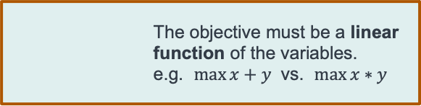
Objectives, decisions, and constraints
Mixed-integer optimization (MIO) is a specific type of optimization that requires certain mathematical structure:
Decision Variables
What are the decisions that we are trying to make?
Variables can be binary (0,1), integer (0,1,2,3,…), or continuous (decimals).
Problem Objective
What objective do we want to maximize (or minimize), as a function of our decision variables?
The objective must be a linear function of the variables.
e.g. $max⁡x+y$ vs. $\max{x}∗y$
Constraints
What are the logical constraints that must be obeyed in any proposed solution?
Notes:
https://jump.dev/JuMP.jl/stable/installation/#Supported-solvers

Slide 20
Objectives, decisions, and constraints
Mixed-integer optimization (MIO) is a specific type of optimization that requires certain mathematical structure:
Decision Variables
What are the decisions that we are trying to make?
Variables can be binary (0,1), integer (0,1,2,3,…), or continuous (decimals).
Problem Objective
What objective do we want to maximize (or minimize), as a function of our decision variables?
The objective must be a linear function of the variables.
e.g. $max⁡x+y$ vs. $\max{x}∗y$
Constraints
What are the logical constraints that must be obeyed in any proposed solution?
Team must obey size restriction and have a sufficient mix of positions.
Notes:
https://jump.dev/JuMP.jl/stable/installation/#Supported-solvers

Slide 21
Objectives, decisions, and constraints
Mixed-integer optimization (MIO) is a specific type of optimization that requires certain mathematical structure:
Decision Variables
What are the decisions that we are trying to make?
Variables can be binary (0,1), integer (0,1,2,3,…), or continuous (decimals).
Problem Objective
What objective do we want to maximize (or minimize), as a function of our decision variables?
The objective must be a linear function of the variables.
e.g. $max⁡x+y$ vs. $\max{x}∗y$
Constraints
What are the logical constraints that must be obeyed in any proposed solution?
Constraints must be linear functions of the variables.
Notes:
https://jump.dev/JuMP.jl/stable/installation/#Supported-solvers

Slide 22
How do we solve these problems?
We use solvers:
They are software packages;
They incorporate one or more algorithms;
They can find solutions to one or more types of problems.
II. Mathematical Formulation
I. Problem
III. Solver
IV. Solution
Notes:
https://jump.dev/JuMP.jl/stable/installation/#Supported-solvers

Slide 23
Recent Speedups in MIO
Many general purpose solvers are available:
CPLEX, Gurobi, GLPK, COIN-OR
In the past 30 years, the speed of integer optimization solvers has increased by a factor of 3 trillion times!
This doesn’t include increasing speed of computers.
A problem that can be solved in 1 second today took 71000 years to solve 30 years ago!
Notes:
https://jump.dev/JuMP.jl/stable/installation/#Supported-solvers

Slide 24
Case Study: Constructing the USA Basketball Dream Team

Slide 25
Constructing an Olympic Team
USA Basketball must decide who to put on the 12-man roster for the
2021 Summer Olympics.
Notes:
https://jump.dev/JuMP.jl/stable/installation/#Supported-solvers

Slide 26
We want to select a high-performing team that meets Olympic regulations and desired constraints on team composition.
Notes:
https://jump.dev/JuMP.jl/stable/installation/#Supported-solvers

Slide 27
We want to select a high-performing team that meets Olympic regulations and desired constraints on team composition.
How can we formalize this optimization problem as a mathematical model?
Notes:
https://jump.dev/JuMP.jl/stable/installation/#Supported-solvers

Slide 28
I. Defining the Decision Variables
Decision Variables
What are the decisions that we are trying to make?
For each candidate player, decide whether or not to include them on the team.
Notes:
https://jump.dev/JuMP.jl/stable/installation/#Supported-solvers

Slide 29
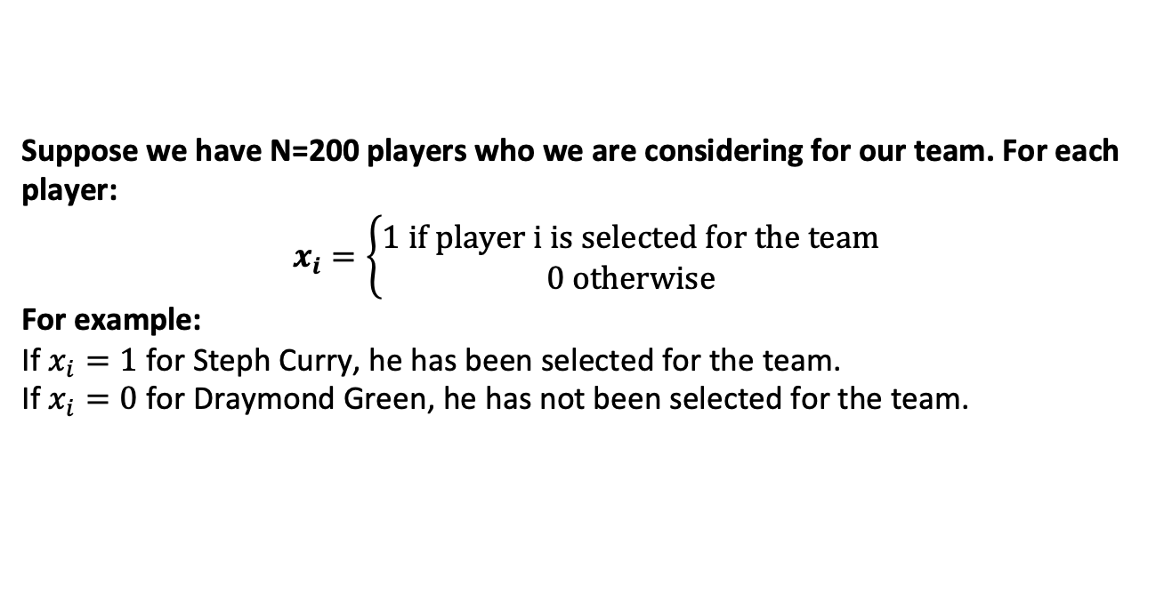
I. Defining the Decision Variables
Decision Variables
What are the decisions that we are trying to make?
For each candidate player, decide whether or not to include them on the team.
Suppose we have N=200 players who we are considering for our team. For each player:
$$x_{i}=\left\{\begin{aligned}1 \text{if} \text{player} \text{i} \text{is} \text{selected} \text{for} \text{the} \text{team} \\ 0 \text{otherwise}\end{aligned}\right.$$
For example:
If $x_{i}=1$ for Steph Curry, he has been selected for the team.
If $x_{i}=0$ for Draymond Green, he has not been selected for the team.
Notes:
https://jump.dev/JuMP.jl/stable/installation/#Supported-solvers

Slide 30
II. Formalizing the Objective
Problem Objective
What objective do we want to maximize (or minimize), as a function of our decision variables?
Maximize team performance.
Notes:
https://jump.dev/JuMP.jl/stable/installation/#Supported-solvers

Slide 31
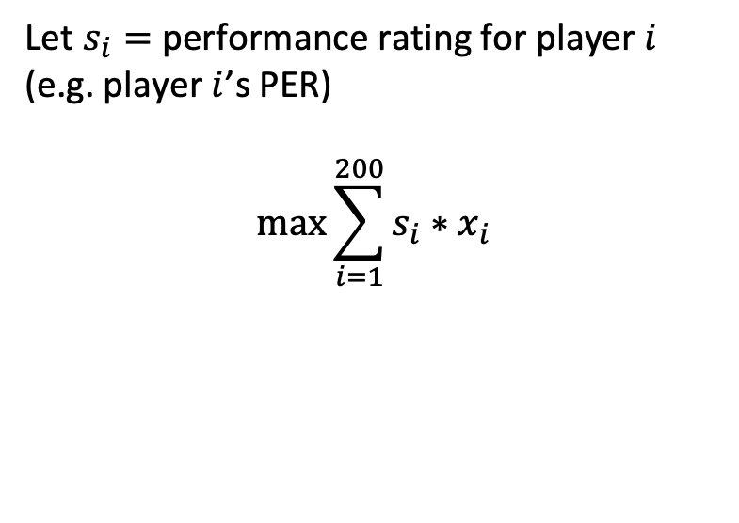
II. Formalizing the Objective
Problem Objective
What objective do we want to maximize (or minimize), as a function of our decision variables?
Maximize team performance.
Let $s_{i}=$ performance rating for player $i$ (e.g. player $i$’s PER)
$$\max{\sum_{i=1}^{200}{{s_{i}∗x}_{i}}}$$
Notes:
https://jump.dev/JuMP.jl/stable/installation/#Supported-solvers

Slide 32
III. Constructing the Constraints
Constraints
What are the logical constraints that must be obeyed in any proposed solution?
Team must obey size restriction and have a sufficient mix of positions.
Notes:
https://jump.dev/JuMP.jl/stable/installation/#Supported-solvers

Slide 33
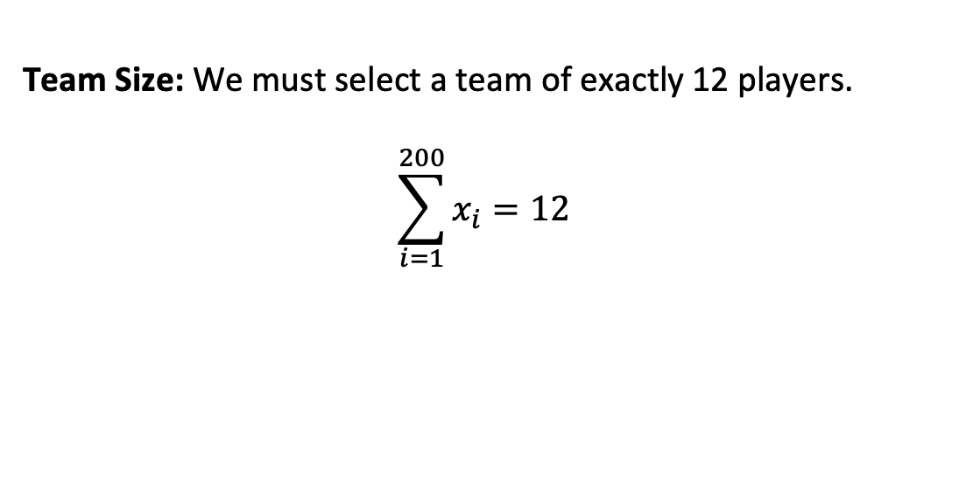
III. Constructing the Constraints
Constraints
What are the logical constraints that must be obeyed in any proposed solution?
Team must obey size restriction and have a sufficient mix of positions.
Team Size: We must select a team of exactly 12 players.
$$\sum_{i=1}^{200}{x_{i}}=12$$
Notes:
https://jump.dev/JuMP.jl/stable/installation/#Supported-solvers

Slide 34
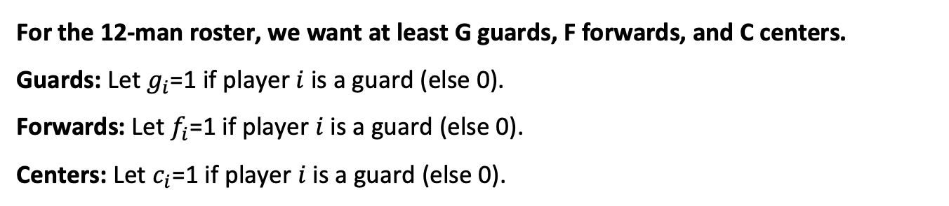
III. Constructing the Constraints
Constraints
What are the logical constraints that must be obeyed in any proposed solution?
Team must obey size restriction and have a sufficient mix of positions.
For the 12-man roster, we want at least G guards, F forwards, and C centers.
Guards: Let $g_{i}$=1 if player $i$ is a guard (else 0).
Forwards: Let $f_{i}$=1 if player $i$ is a guard (else 0).
Centers: Let $c_{i}$=1 if player $i$ is a guard (else 0).
Notes:
https://jump.dev/JuMP.jl/stable/installation/#Supported-solvers

Slide 35
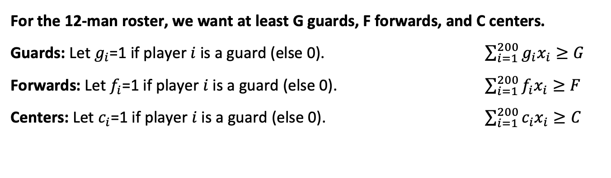
III. Constructing the Constraints
Constraints
What are the logical constraints that must be obeyed in any proposed solution?
Team must obey size restriction and have a sufficient mix of positions.
For the 12-man roster, we want at least G guards, F forwards, and C centers.
Guards: Let $g_{i}$=1 if player $i$ is a guard (else 0). $\sum_{i=1}^{200}{g_{i}x_{i}}≥G$
Forwards: Let $f_{i}$=1 if player $i$ is a guard (else 0). $\sum_{i=1}^{200}{f_{i}x_{i}}≥F$
Centers: Let $c_{i}$=1 if player $i$ is a guard (else 0). $\sum_{i=1}^{200}{c_{i}x_{i}}≥C$
Notes:
https://jump.dev/JuMP.jl/stable/installation/#Supported-solvers

Slide 36
MIO offers a flexible decision framework
Incorporating new constraints:
NBA Team Diversity: Ensure that at least 5 distinct teams are represented on the roster.
Injury Adjustments: If a player becomes injured, we can force his decision variable to be 0 in the constraints.
Team capabilities: Beyond DBPM, we could have added constraints on average value for other metrics. We could also constrain the minimum value, such as saying that we require players to have at least a DBPM of 0 to be considered for the team.
Notes:
https://jump.dev/JuMP.jl/stable/installation/#Supported-solvers

Slide 37
MIO offers a flexible decision framework
Incorporating new constraints:
NBA Team Diversity: Ensure that at least 5 distinct teams are represented on the roster.
Injury Adjustments: If a player becomes injured, we can force his decision variable to be 0 in the constraints.
Team capabilities: Beyond DBPM, we could have added constraints on average value for other metrics. We could also constrain the minimum value, such as saying that we require players to have at least a DBPM of 0 to be considered for the team.
Considering other objectives:
On a professional sports team, ownership wants to maximize performance while also controlling costs. We could add a budget term to the objective (to be balanced with performance).
Notes:
https://jump.dev/JuMP.jl/stable/installation/#Supported-solvers

Slide 38
MIO offers a flexible decision framework
Incorporating new constraints:
NBA Team Diversity: Ensure that at least 5 distinct teams are represented on the roster.
Injury Adjustments: If a player becomes injured, we can force his decision variable to be 0 in the constraints.
Team capabilities: Beyond DBPM, we could have added constraints on average value for other metrics. We could also constrain the minimum value, such as saying that we require players to have at least a DBPM of 0 to be considered for the team.
Considering other objectives:
On a professional sports team, ownership wants to maximize performance while also controlling costs. We could add a budget term to the objective (to be balanced with performance).
Capturing interactions between players:
Certain people play better when in a pair than on their own, so we may want to add constraints that the players must always appear together (or conversely, cannot both be on the team).
Notes:
https://jump.dev/JuMP.jl/stable/installation/#Supported-solvers

Slide 39
Main Takeaways
Mixed-Integer Optimization (MIO) is a powerful tool for modeling real-world decision problems and offering objective solutions.
The biggest challenge of MIO is defining and quantifying the problem.
Once a problem is formalized, Julia offers an easy-to-use interface that allows us to quickly solve large problems.
MIO has a flexible framework that allows us to easily experiment with different objectives, constraints, and model parameters.
Notes:
https://jump.dev/JuMP.jl/stable/installation/#Supported-solvers

Slide 40
Further reading
Resources for learning Julia (I recommend the Manual)
Julia’s performance tips, workflow tips and style guide
A comprehensive list of differences between Julia and Python (and other languages)
A talk (35min) explaining what multiple dispatch is in Julia and why it works
https://jump.dev/JuMP.jl/stable/installation/#Supported-solvers
Notes:
https://jump.dev/JuMP.jl/stable/installation/#Supported-solvers

Slide 41
Thank you!

